Slide 1
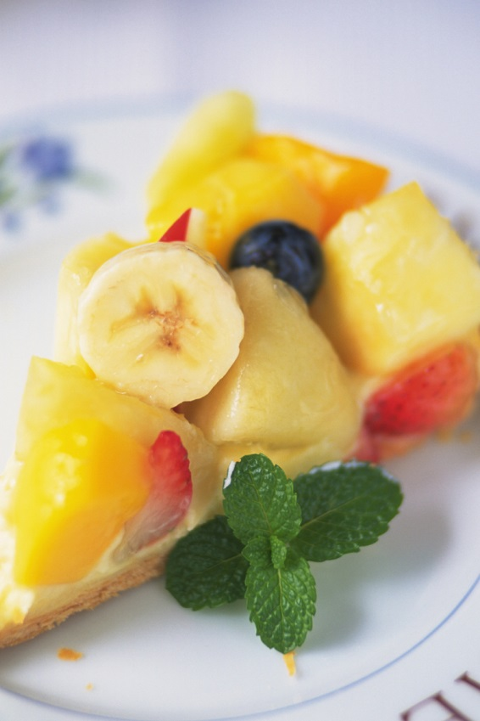
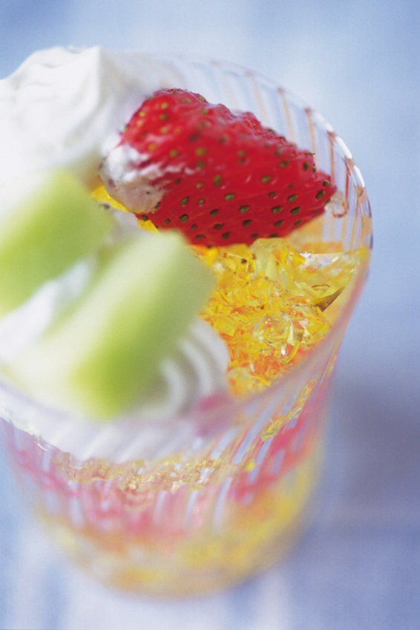
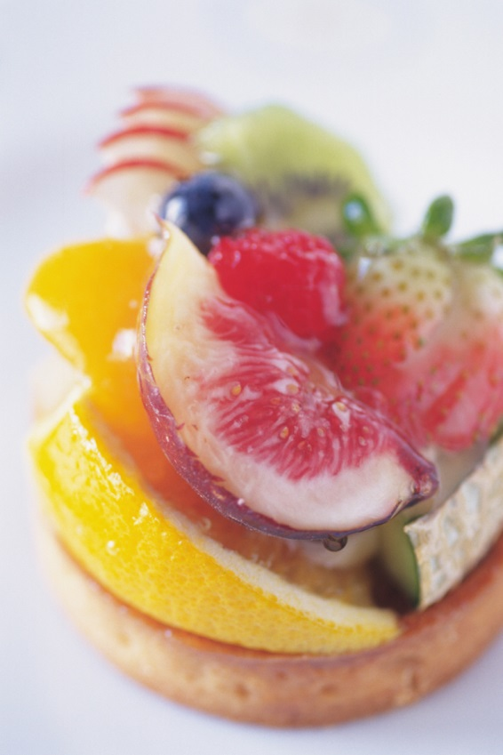
REC CAFE
REC CAFE
REC CAFE
v
v
Fruit Cake
450ayen
Fruit Cake
450ayen
Fruit Cake
450ayen

